Slide 1
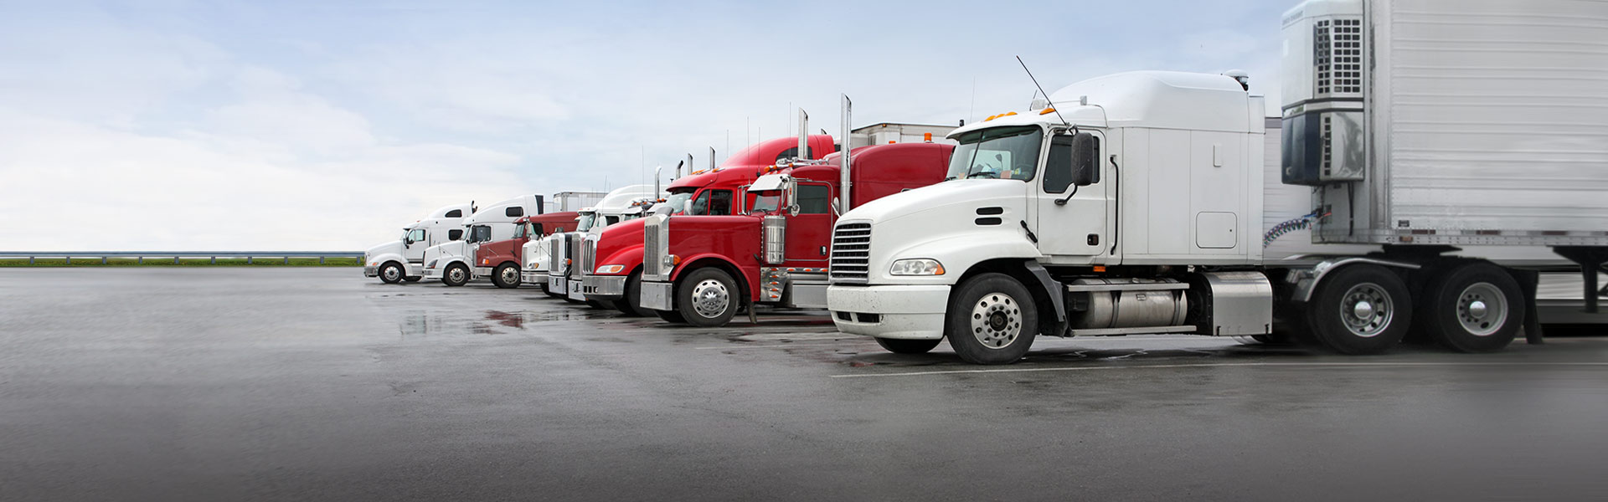
TEAM 5
Ahana Roy
Dhruv Rakesh Shah
Gayathri Anantharaman
Mukil Raj Kannan
Pooja Bhamare

Slide 2
ABOUT THE COMPANY
OBJECTIVE
AZ National Trucking
HQ – California
Primary business
Long distance trucking services – general and non specialized cargo
No of Employees – 400
310 drivers
Trucks
310 (ANT owned and contracted)
Geographies covered – parts of Western United States, parts of Canada, parts of Mexico
To analyze insurance risk associated with the truck fleet based on geographic location and time using HDP tools and techniques.
PROBLEM STATEMENT
Analyzed a sample of 100 trucks to determine risk factor threshold for each driver and trigger alert notifications to corporate management and insurance if it exceeded the threshold.

Slide 3

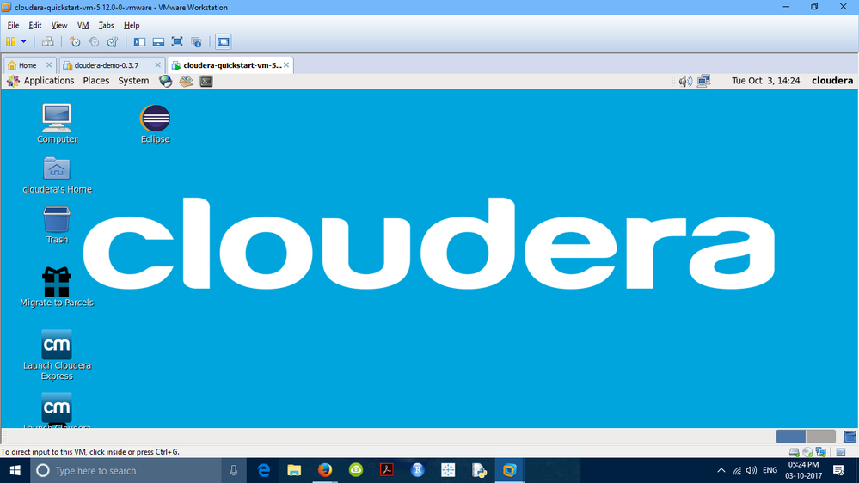

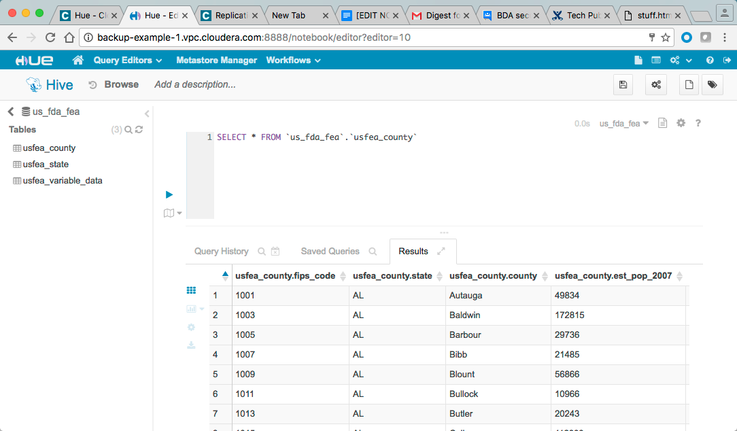


PROCESS FLOW
STEPS FOLLOWED :
XLSX to CSV conversion
Calculations
Risk factor per driver= event/total miles
Normalize the values to a scale of 0 to 10
Transfer csv files into Cloudera VM
Transfer
Use scp command
Local system → Cloudera VM
Load data from Cloudera VM into HDFS
Using put command
Source – /home/training materials
Destination - /loudacre/project
Create a HIVE table for every csv file
Table creation and loading data
Separate hive table for each csv file
Geolocation, driver mileage, average mileage, trucks, riskfactor, etc
Load data from HDFS into HIVE
Load Data Inpath
Moves data within HDFS
Source - /loudacre/project , Destination – each table
Integrate HDFS with Tableau and load data into Tableau
Download JDBC drivers
Connect Cloudera Hadoop with Tableau
For Impala: INVALIDATE METADATA, tables are reflected in Tableau.

Slide 4
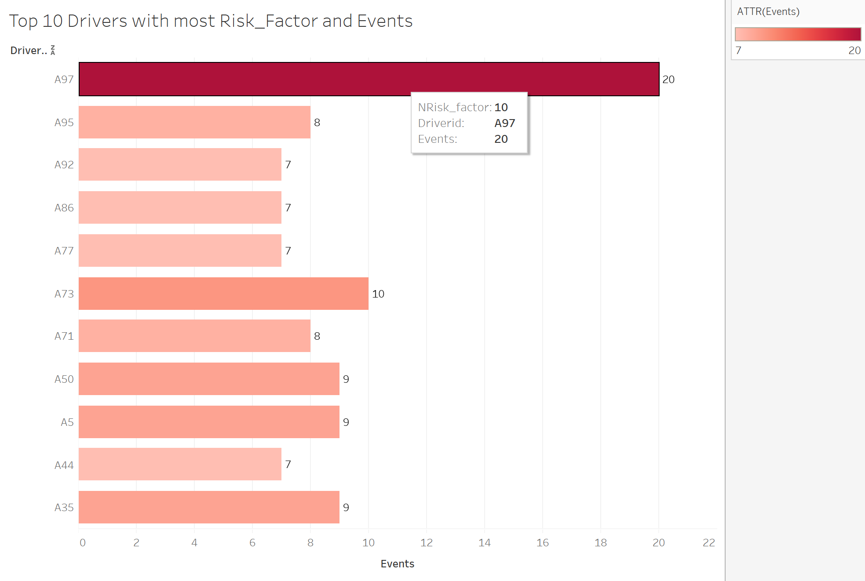
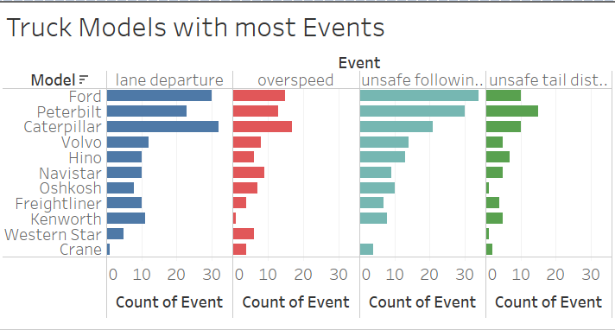
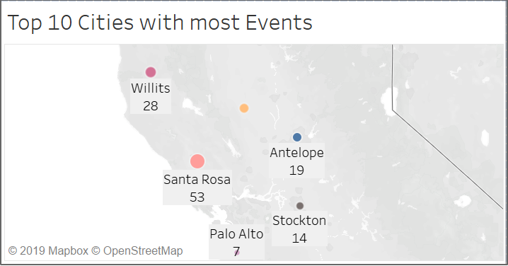
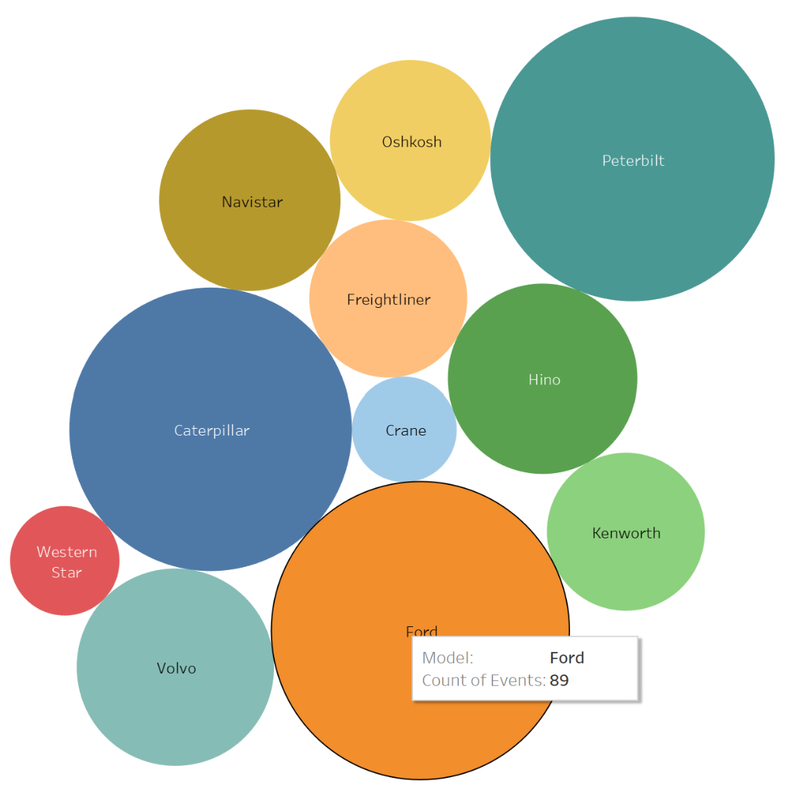
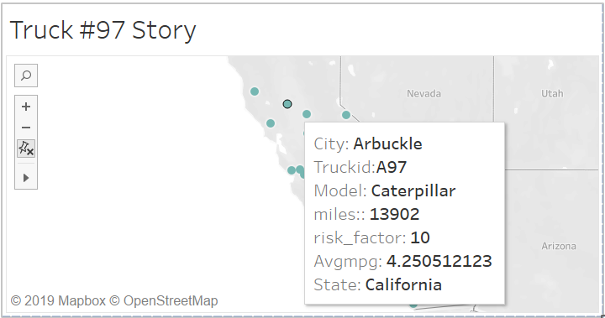
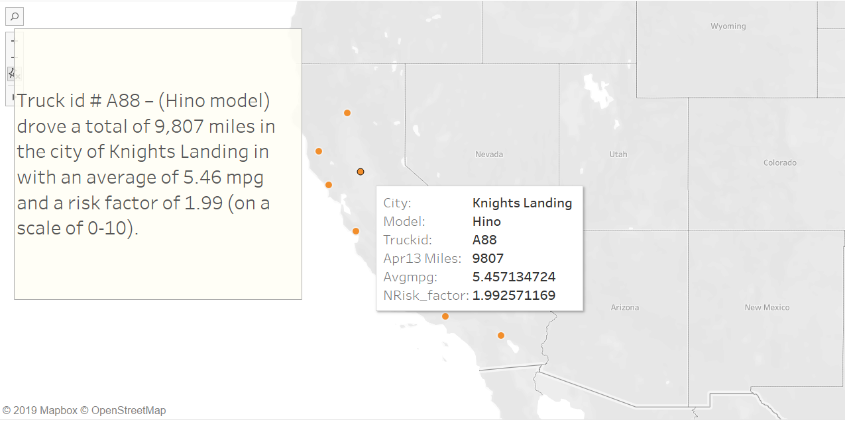

Slide 5
QUESTIONS?
THANK YOU!

